Slide 1
Introduction to Programming with Python
Shuyang Liu, Swapnil Sayan Saha
PhD Students, CS and ECE
sliu44@cs.ucla.edu, swapnilsayan@g.ucla.edu
July 13, 2020 Note: modified from original LACC slides by Prof. Lucas Wanner, Prof. Mani Srivastava, Dr. Mark Gottscho,
Dr. Bharathan Balaji, Wojciech Romaszkan and Aishwarya Sivaraman

Slide 2


Welcome to LACC 2020 @ UCLA!
Introductions
Name?
High school?
Favorite activity outside school?
Something interesting or different about you?
What excites you about computing or engineering?
LACC 2020, Module 1: Intro to Programming with Python
LACC 2020, Module 1: Intro to Programming with Python

Slide 3
Introduction to Computers
A computer is an electronic programmable machine that can process almost all kinds of data. Fundamentally, a computer is a “calculating machine”.
A computer performs arithmetic and logical operations.
Ref: http://softttec.blogspot.com
LACC 2020, Module 1: Intro to Programming with Python

Slide 4
The Language of Computers
A computer program is a set of instructions that dictates the steps required to perform a given task via some predefined syntax and semantics.
A computer only understands 1s and 0s – bits (binary digits); 1 byte = 8 bits.
Ref: http://web.alfredstate.edu/faculty/weimandn/miscellaneous/ascii/ascii_index.html
LACC 2020, Module 1: Intro to Programming with Python

Slide 5
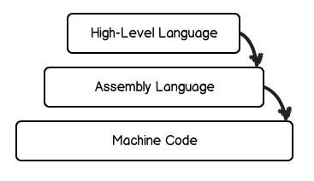
Communicating with Computers
Humans do not communicate in binary.
We code in human-readable programming languages
Allow us to express programs in a way that is closer to natural languages
Provide libraries of commonly-used sub-tasks (functions)
Translate high level code into machine code through compilers or interpreters
Given a language providing…
function definitions and calls, f(x)
a library function, print(“text”)
comparisons, x == y
assignments, x = y
conditional statements, if (condition) ... else …
Ref: http://shawnbiddle.com/js101/slides/class1.html#/6
LACC 2020, Module 1: Intro to Programming with Python

Slide 6

Why do we choose Python?
Relatively simple syntax.
Relatively easy to debug.
Availability of open-source tools and modules/libraries for eclectic applications with large development community.
Platform agnostic (runs anywhere).
Broad application spectrum, e.g. web applications / frameworks, standalone applications, video games, data science, artificial intelligence, machine learning, embedded systems etc.
LACC 2020, Module 1: Intro to Programming with Python
Notes:
Show the Python’s advantages. Compare them with English to make Python more familiar to students.

Slide 7
Getting and Learning Python
Python Official Website: http://www.python.org
Virtual environments with prebuilt Python modules:
Anaconda: https://www.anaconda.com/products/individual
Jupyter: https://jupyter.org/install
Standalone Python IDEs:
Pycharm: https://www.jetbrains.com/pycharm/
Thonny: https://thonny.org
Browser-based Python IDEs:
Google Colab: https://colab.research.google.com
Trinket: https://trinket.io/python
Tutorials (basic syntax and semantics):
Official Tutorial: https://docs.python.org/3/tutorial/
Tutorial by Bucky Roberts: https://www.youtube.com/playlist?list=PL6gx4Cwl9DGAcbMi1sH6oAMk4JHw91mC_
Google: https://developers.google.com/edu/python/
LACC 2020, Module 1: Intro to Programming with Python

Slide 8
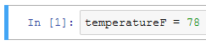
Python Basics: Variables, Types & Operators
What is a Variable?
A variable is a place in memory, which has a name, and where you can store a value (a number, phrase, etc.).
Assigning Values to Variables:
Python variables are declared automatically when you assign a value to a variable.
The equal sign ( = ) is used to assign values to variables.
Values may be of different “types”
Operators perform arithmetic and logical operations over variables and values.
LACC 2020, Module 1: Intro to Programming with Python
Notes:
In computing, memory refers to the state information of a computing system, as it is kept active in some physical structure. By design, the term “memory” refers to temporary state devices, whereas the term “storage” is reserved for permanent data.

Slide 9
Interacting with the External World (Users, and Files)
Printing to the Screen (Hello World!)
Reading Keyboard Input: raw_input([prompt])
Reading and Writing Files
>>> print "Python is really a great language,", "isn't it?”;
Python is really a great language, isn't it?
# file.py
str = raw_input("Enter your input: ");
print "Received input is : ", str
Enter your input: Hello Python
Received input is : Hello Python
#!/usr/bin/python
# Open a file
fo = open("foo.txt", "wb")
fo.write( "Python is a great language.\nYeah its great!!\n");
# Close opend file
fo.close()
#!/usr/bin/python
# Open a file
fo = open("foo.txt", "r+")
str = fo.read(10);
print "Read String is : ", str
# Close opend file
fo.close()
Ref: http://www.tutorialspoint.com/
LACC 2020, Module 1: Intro to Programming with Python

Slide 10
Exercise A – Printing to the Screen
Open the Jupyter Notebook in Google Colab.
We will discuss the section titled “The Very First Step” (Exercise 0).
We will complete the section titled “The Very First Step” (Exercise 0).
LACC 2020, Module 1: Intro to Programming with Python

Slide 11
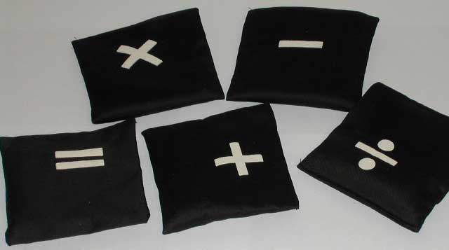
Python Operators
What is an operator?
Python operators are very similar to the mathematical operators we use everyday. For example, +, -, *…
LACC 2020, Module 1: Intro to Programming with Python
Notes:
Introduce Python operators.

Slide 12
Python Basic Operators
Python Operator Types:
Arithmetic Operator
Comparison Operators
Logical (or Relational) Operators
Assignment Operator
LACC 2020, Module 1: Intro to Programming with Python
Notes:
The basic python operator types.

Slide 13
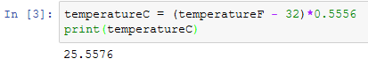
Python Arithmetic Operators
Assume variable a holds 10 and variable b holds 20 then:
Addition | a + b = 30
Subtraction | b – a = 10
Multiplication | a * b = 200
Division | b / a = 2
Reminder | b % a = 0
Exponent | a ** b = 10²⁰
LACC 2020, Module 1: Intro to Programming with Python
Notes:
Show how the arithmetic operators work with the examples in the table.

Slide 14
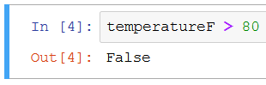
Python Comparison Operators
Assume variable a holds 10 and variable b holds 20 then:
Equality | a == b = False
Inequality | a != b = True
Less than | a < b = True
Greater than | a > b = False
Less than or equal | a <= b = True
Greater than or equal | a >= b = False
LACC 2020, Module 1: Intro to Programming with Python
Notes:
Show how the comparison operators work with the examples in the table.

Slide 15
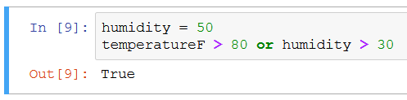
Python Logical Operators
Assume variable a holds True and variable b holds False then:
Logical AND | a and b = False
Logical OR | a or b = True
Logical NOT | not a = False
LACC 2020, Module 1: Intro to Programming with Python
Notes:
Show how the comparison operators work with the examples in the table.

Slide 16
Python Data Types
In computer programming, a data type is a classification identifying one of various types of data, just like in real life we separate words “Hello!” and numbers “12345”.
Standard Data Types in Python:
Numbers, e.g., 1000
String, e.g., “Hello world!”
Boolean e.g. True
List, a container e.g., [365, 12, 30]
Dictionary, a key-indexed container.
LACC 2020, Module 1: Intro to Programming with Python
Notes:
We introduce the five standard data types in Python here. In the following slices, we will study them in more detail.

Slide 17
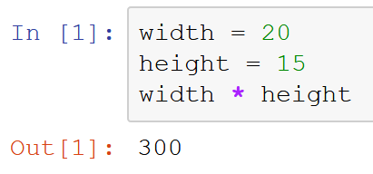
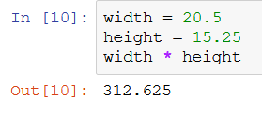
Python Types: Numbers
Numbers
Store numeric values,
Example:
In this example, “width = 20” defines variable width to be 20, and “height = 15” defines height to be 15. This sort of number is called integer or int.
After initializing width and height, we can calculate width * height as shown in the example.
To use real numbers (also called float / double), add a dot:
LACC 2020, Module 1: Intro to Programming with Python
Notes:
Provide an example for number variables.

Slide 18
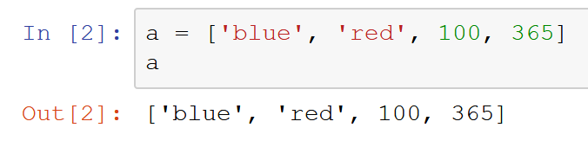
Python Types: Lists
Lists:
Lists are the most versatile of Python’s compound data types. A list contains items separated by commas and enclosed within square brackets.
Example:
In this example, we assign four items to list a. The items are string ‘blue’, string ‘red’, number 100, and number 365.
We print a’s items in the second command, and get its four items printed.
Note that items in the list have different types (string and int) – this is not common among programming languages.
LACC 2020, Module 1: Intro to Programming with Python
Notes:
Show the concept of lists, and show an example.

Slide 19
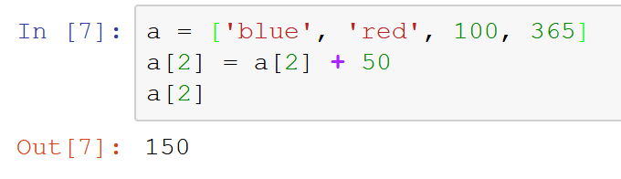
Python Types: Lists
Lists:
It is possible to change individual elements of a list.
Example:
In this example we modify the third element in the list by adding 50 to its value
We then print the third element by using name[index]
Note that list’s subscript starts from 0
LACC 2020, Module 1: Intro to Programming with Python
Notes:
Another example for list variables.

Slide 20
Python Types: Lists
Lists:
Many “operations” and “methods” available for lists:
+ sort, concatenate, insert, sum and many more at: https://docs.python.org/2/tutorial/datastructures.html#more-on-lists
Is the value in the list? | 100 in a = True
Is the value not in the list? | ‘yellow’ not in a = True
Length of the list | len(a) = 4
Index of an element | a.index(‘red’) = 1
Append element | a.append(10)
Reverse the list | a.reverse()
LACC 2020, Module 1: Intro to Programming with Python
Notes:
Another example for string variables.

Slide 21
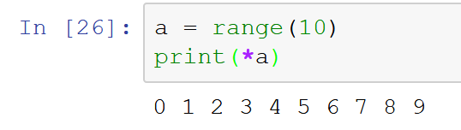
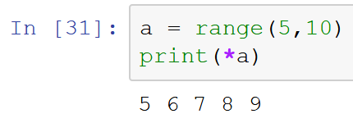
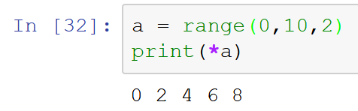
Python Types: Range
Creating number sequences:
range(n) for integer n > 0 returns the list [0, 1, … n-1]
range(m,n) returns the list [m, m+1, … n-1]
range(m,n,o) returns the list [m, m+o, … n-1]
LACC 2020, Module 1: Intro to Programming with Python
Notes:
Another example for list variables.

Slide 22
Exercise B – Lists, Variables and Data Types
Open the Jupyter Notebook in Google Colab.
We will discuss the section titled “Variables and Types” (Exercise 1, 2 and 3).
We will complete the section titled “Variables and Types” (Exercise 1, 2 and 3).
LACC 2020, Module 1: Intro to Programming with Python

Slide 23
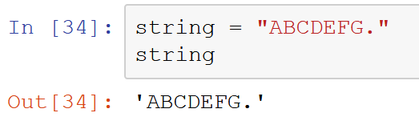
Python Types: Strings
Strings:
Strings in Python are identified as a contiguous set of characters in between quotation marks.
Example:
In this example, we assign “ABCDEFG.” to variable string. And we print string.
The result we get is still “ABCDEFG.”
You can use double “ or single ‘ quotation marks for strings in Python, they are equivalent.
LACC 2020, Module 1: Intro to Programming with Python
Notes:
Show the concept of strings, and show an example.

Slide 24
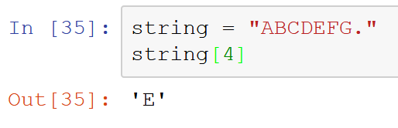
Python Types: Strings
Strings:
Strings can be subscripted (indexed). This is because they are essentially lists of characters.
Example: In the string defined as str = “ABCDEFG.”, we query the fifth letter in this string.
Because it’s a list, first letter has index 0
LACC 2020, Module 1: Intro to Programming with Python
Notes:
Another example for string variables.

Slide 25
Python Types: Strings
Strings:
Many “operations” and “methods” available for strings:
and many more at https://docs.python.org/2/library/stdtypes.html#string-methods
Is the letter in the string? | ‘A’ in string = True
Is the substring in the string? | ‘CDE’ in string = True
Length of the string | len(string) = 8
Index of a letter (first) | string.index(‘A’) = 0
Append element | string + “Z” = “ABCDEFG.Z”
Make lowercase | string.lower() = “abcdefg.”
LACC 2020, Module 1: Intro to Programming with Python
Notes:
Another example for string variables.

Slide 26
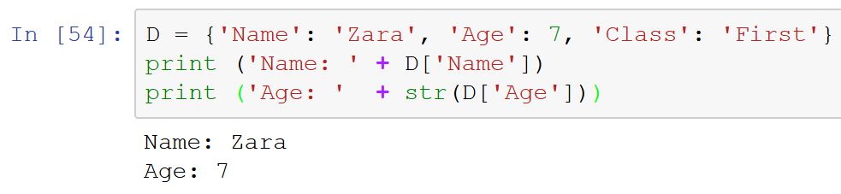
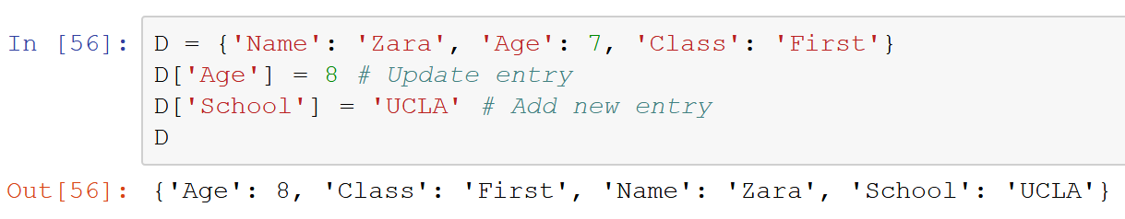
Python Types: Dictionaries
Dictionaries:
Represents a set of key-value pairs where keys are unique (i.e. numbers, strings) but values need not be. It’s not ordered.
Example:
Updating a dictionary
LACC 2020, Module 1: Intro to Programming with Python
Notes:
Show the concept of lists, and show an example.

Slide 27
Beyond Sequential Execution: Control Flow Tools
Programming languages provide various control structures that allow for more complicated execution paths instead of just sequential
Make decisions on what to do dynamically while the program runs!
If…then
Loop
Ref: http://www.tutorialspoint.com/
LACC 2020, Module 1: Intro to Programming with Python

Slide 28
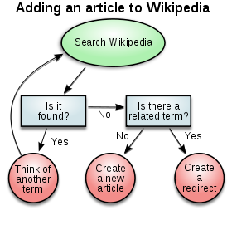
Python Basics: Decision Making
Decision Making:
Conditional constructs are used to incorporate decision making into programs.
The result of this decision making determines the sequence in which a program will execute instructions.
LACC 2020, Module 1: Intro to Programming with Python
Notes:
Decision making can be regarded as the mental processes resulting in the selection of a course of action among several alternative scenarios. Every decision making process produces a final choice. The output can be an action or an opinion of choice.

Slide 29
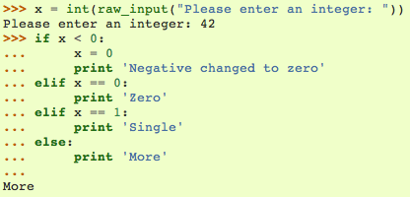
Python Basics: Decision Making
if Statement
The if statement contains a logical expression using which data is compared, and a decision is made based on the result of the comparison.
Example:
In this example, we input integer 42, which is not less than 0, not equal to 0, and not equal to 1. Therefore, it falls into the option that “print ‘More’”.
Any non-zero and non-null values are treated as TRUE by Python
LACC 2020, Module 1: Intro to Programming with Python
Notes:
Show the concept of if statement, and show an example.

Slide 30
Python Basics: Looping
for statement
The for loop in Python has the ability to iterate over the items of any sequence, such as a list, tuple, or a string.
Ref: http://www.tutorialspoint.com/
LACC 2020, Module 1: Intro to Programming with Python
Notes:
Show the concept of for statement, and show an example.

Slide 31
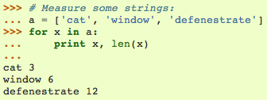
Python Basics: Looping
for statement
The for loop in Python has the ability to iterate over the items of any sequence, such as a list or a string.
Example:
In this example, all the items in list a get printed.
len(x) is a built-in function in Python, which returns the length of x.
In this example, x is a string, such as “cat”. len(x) returns “cat”’s length, which is 3.
LACC 2020, Module 1: Intro to Programming with Python
Notes:
Show the concept of for statement, and show an example.

Slide 32
Python Basics: Looping
while statement
The while loop in Python has the ability to iterate over a statement or group of statements while a given condition is TRUE
Ref: http://www.tutorialspoint.com/
LACC 2020, Module 1: Intro to Programming with Python
Notes:
Show the concept of for statement, and show an example.

Slide 33
Python Basics: Looping
while statement
The while loop in Python has the ability to iterate over a statement or group of statements while a given condition is TRUE
Example:
Caution: “infinite loop” if a condition never becomes false.
count = 0
while (count < 9):
print 'The count is:', count
count = count + 1
print "Good bye!"
The count is: 0
The count is: 1
The count is: 2
The count is: 3
The count is: 4
The count is: 5
The count is: 6
The count is: 7
The count is: 8
Good bye!
Ref: http://www.tutorialspoint.com/
LACC 2020, Module 1: Intro to Programming with Python
Notes:
Show the concept of for statement, and show an example.

Slide 34
Python Basics: Loop Control Statements
for letter in 'Python':
if letter == 'h':
break
print 'Current Letter :', letter
for letter in 'Python':
if letter == 'h':
continue
print 'Current Letter :', letter
Ref: http://www.tutorialspoint.com/
LACC 2020, Module 1: Intro to Programming with Python

Slide 35
Exercise C – Looping
Open the Jupyter Notebook in Google Colab.
We will discuss the sections titled “A Simpler way to print: Using for loops”, “Interacting with the outside world: I/O” and “if Checks” (Exercise 4, 5 and 6).
We will complete these sections as well (Exercise 4, 5 and 6).
LACC 2020, Module 1: Intro to Programming with Python

Slide 36
Python Basics: Functions
Defining and Calling Functions:
A function is a block of organized, reusable code that is used to perform a single, related action.
Functions provides better abstraction and modularity for your application and a high degree of code reusing
Makes your code simpler and easier to read!
Calling a function: Once the basic structure is finalized, you can execute it by calling it from another function or directly from the Python prompt.
LACC 2020, Module 1: Intro to Programming with Python
Notes:
Reusable: In computer science and software engineering, reusability is the likelihood a segment of source code that can be used again to add new functionalities with slight or no modification.

Slide 37
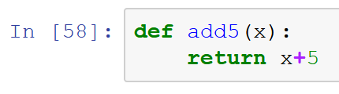
Defining Functions
By defining a function, we can put a routine into this function, and we will be able to execute this routine simply by calling this function.
For example, we introduce a function “add5”, which add t onto the integer we passed into the function.
Example:
In this function, x is the integer we passed into the function. And the function will return the value of x+5 back.
LACC 2020, Module 1: Intro to Programming with Python
Notes:
Show how to define a simple function in python. This function add 5 onto the number passed into the function.

Slide 38
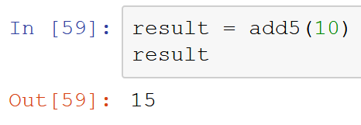
Calling the Function
To call the function add5 we just defined, we simply do:
By passing number 10 into the add5 function, 5 is added.
The result then equals to 15.
LACC 2020, Module 1: Intro to Programming with Python
Notes:
Show how to use the function by example.

Slide 39
Python Modules and Namespaces
A module is a file consisting of Python code which can define functions, variables etc.
The code for a module named mname normally resides in the file mname.py which is searched for in selected folders on the computer
Any Python source file can be used as as a module by executing an import statement in some other Python source file.
To prevent confusion with same variable and function names being used in different modules, they belong to a module’s namespace which is a dictionary of variable names (keys) and their corresponding objects (values).
Each function has its own local namespace, and a Python statement can directly access variables in the local namespace and in a global namespace.
# file: support.py
def print_func( par ):
print "Hello : ", par
return
# some other file
import support
# Now one can call function defined in that module as follows
support.print_func("Zara")
LACC 2020, Module 1: Intro to Programming with Python

Slide 40
Some Very Useful Python Modules
matplotlib: a python plotting library
NumPy: computing with n-dimensional arrays
Tensorflow: AI, machine learning and data science
SciPy: data science, numerical integration and optimization
Sympy: symbolic mathematics
scikit-learn: data mining and machine learning
pygame, pyget: games
and many many more…
LACC 2020, Module 1: Intro to Programming with Python

Slide 41
Exercise D – Wrapping Up
Open the Jupyter Notebook in Google Colab.
We will discuss the section titled “The Game Loop: while loop” (Exercise 7).
We will complete the section as well. (Exercise 7).
LACC 2020, Module 1: Intro to Programming with Python

